Slide 1

SLAs and Entitlements
DYNAMICS 365

Slide 2

Mitch Milam
Dynamics CRM Architect
mitch@xrmcoaches.com
@mitchmilam
http://tinyurl.com/MitchMilamLinkedIn

Slide 3
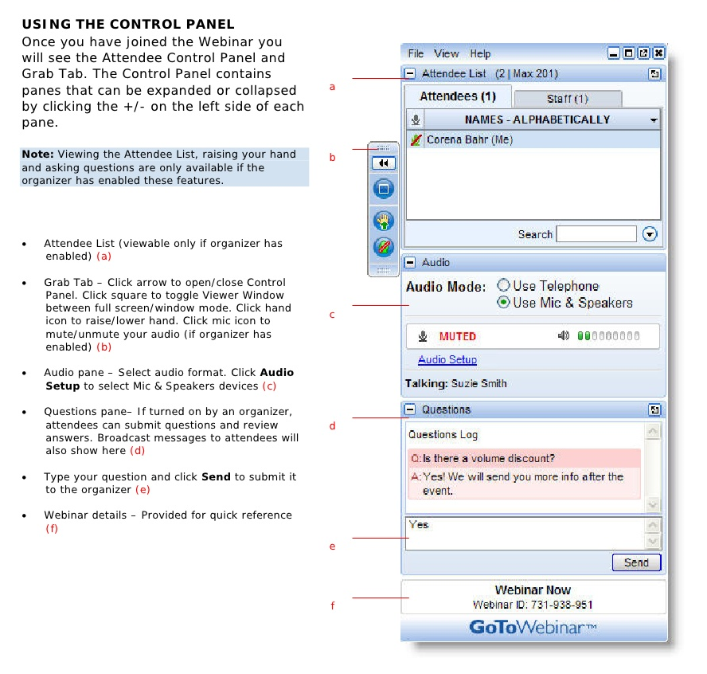
Webinar Housekeeping

Slide 4
2017 Training Resources
Webinars
http://www.xrmcoaches.com/webinars
KnowledgeBits
http://www.xrmcoaches.com/knowledgebits
Learning Plans
http://www.xrmcoaches.com/freestuff

Slide 5
Agenda
What we are discussing today
SLAs
Entitlements

Slide 6
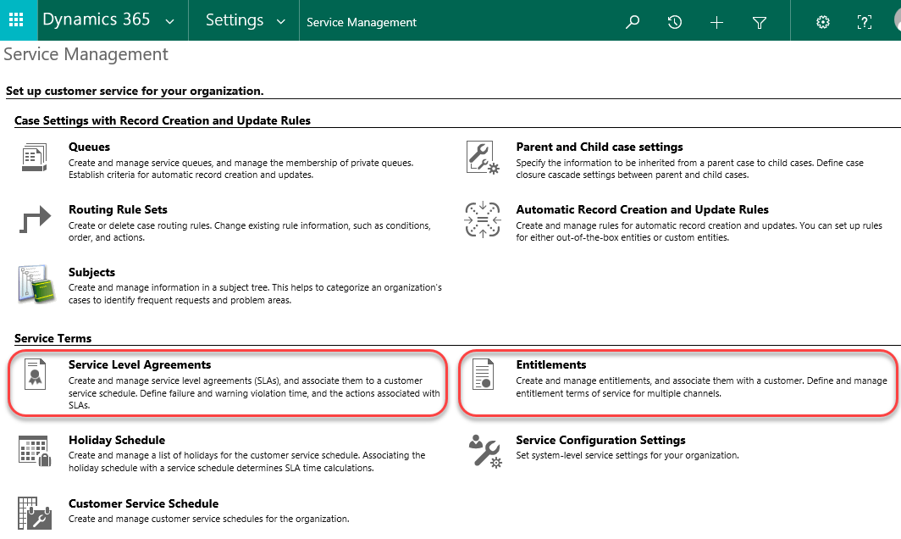
SLAs and Entitlements

Slide 7
SLAs

Slide 8
What is an SLA?
Service Level Agreement is an agreement or contract between a service provider (which could be your company) and its customers.

Slide 9
Where are SLAs?
All activity entities (email, appointment, etc.)
Except recurring appointment
Account
Contact
Order
Invoice
Quote
Opportunity
Lead
Custom entities and custom activities
* Starting with Dynamics CRM 2016 Spring Release (8.1)

Slide 10
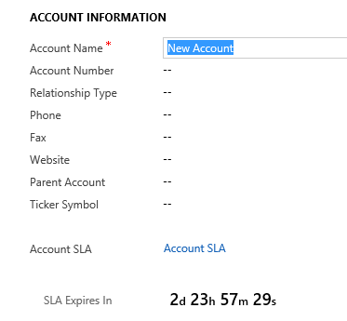
SLA in Action (Account)

Slide 11
Warning
Configuring and Creating SLAs involves more than a little “chicken vs. the egg” scenarios

Slide 12
Adding an SLA to an Entity

Slide 13
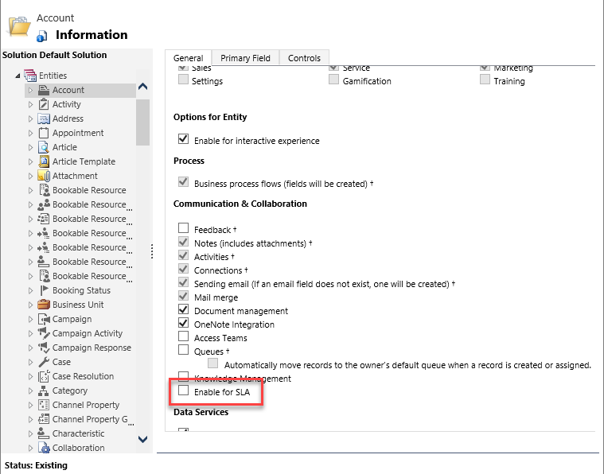
Enable SLAs on the Entity (Account)

Slide 14
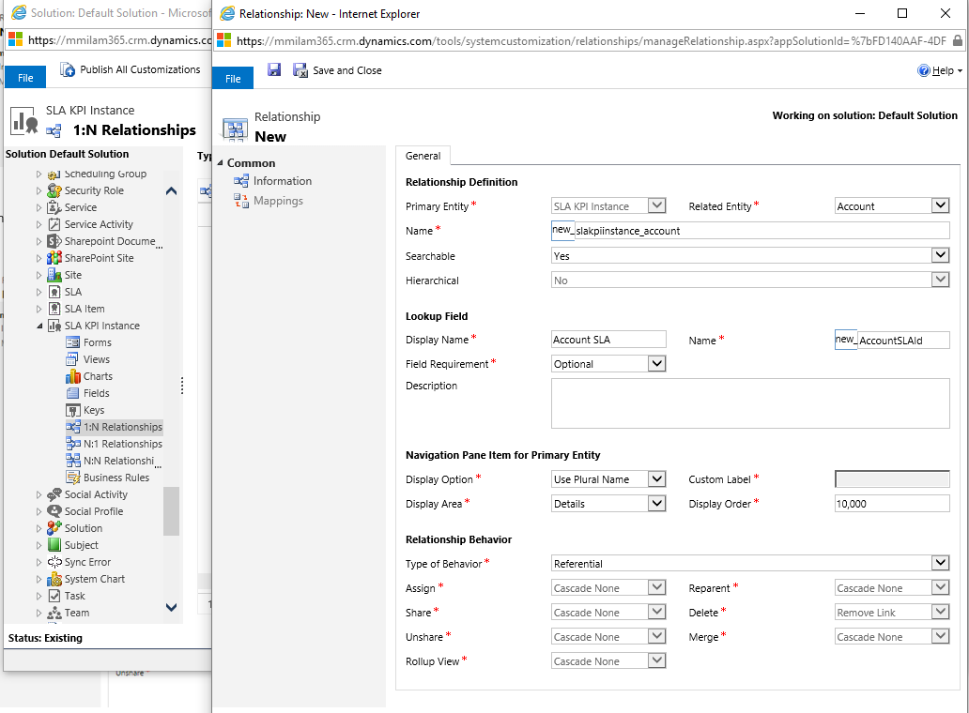
New 1:N Relationship (SLA KPI Instance)

Slide 15
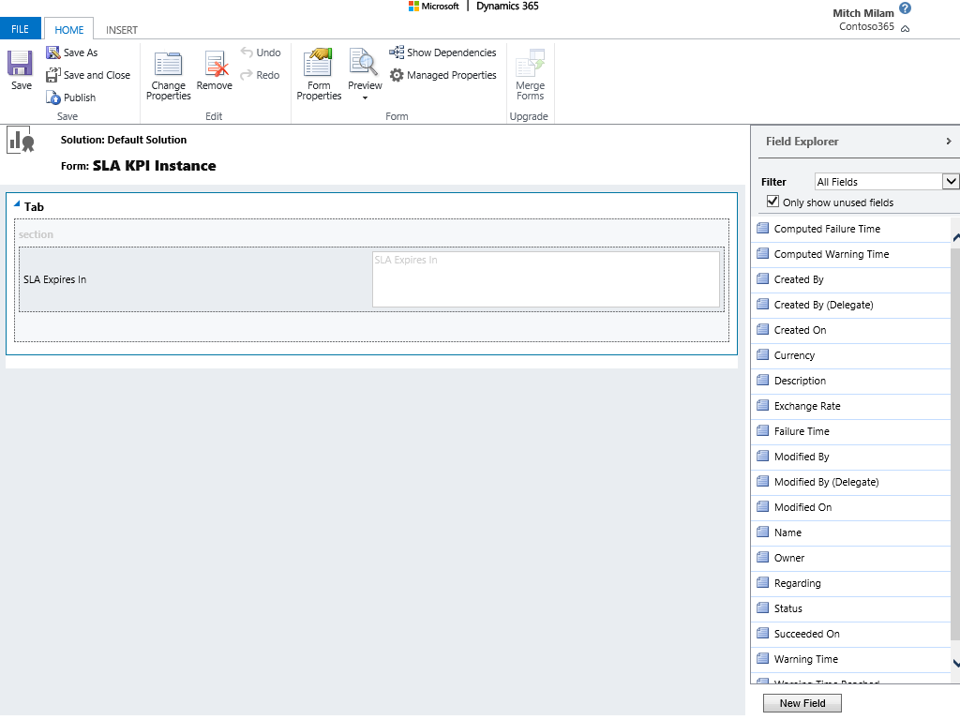
Create a Quick View Form (SLA KPI Instance)

Slide 16
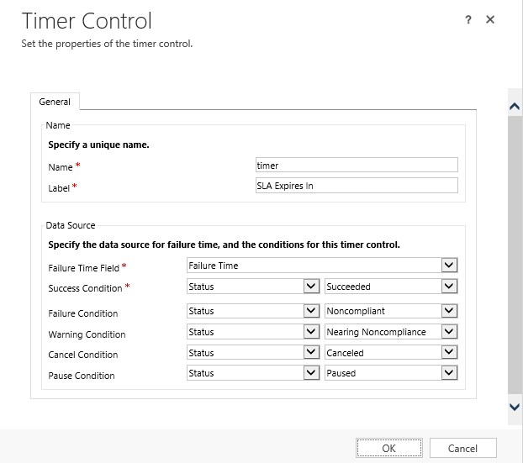
Add a Time Control (SLA KPI Instance)

Slide 17
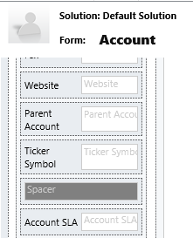
Add the SLA Field (Account)

Slide 18
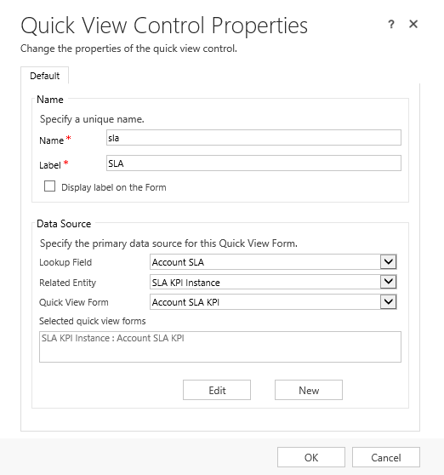
Add SLA Timer to Form (Account)

Slide 19
Enabling and Creating SLAs

Slide 20
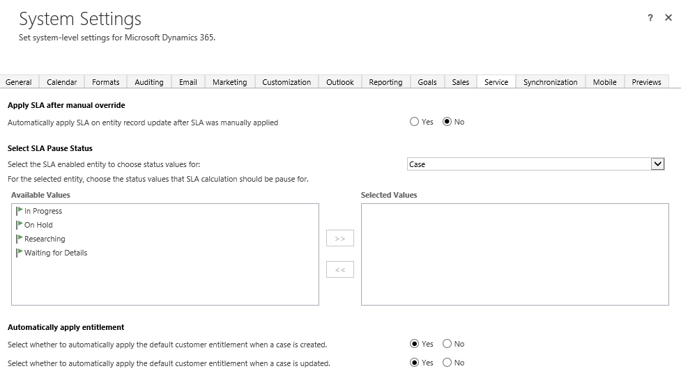
Enabling SLAs

Slide 21
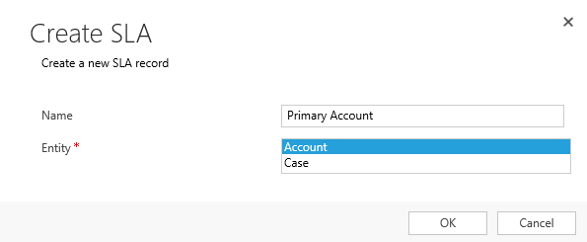
Create an SLA

Slide 22
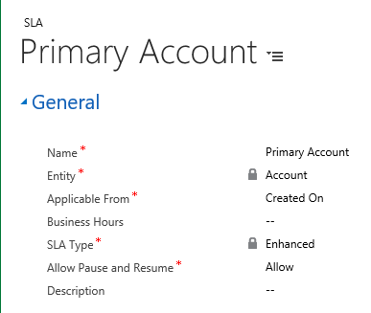
Create an SLA

Slide 23
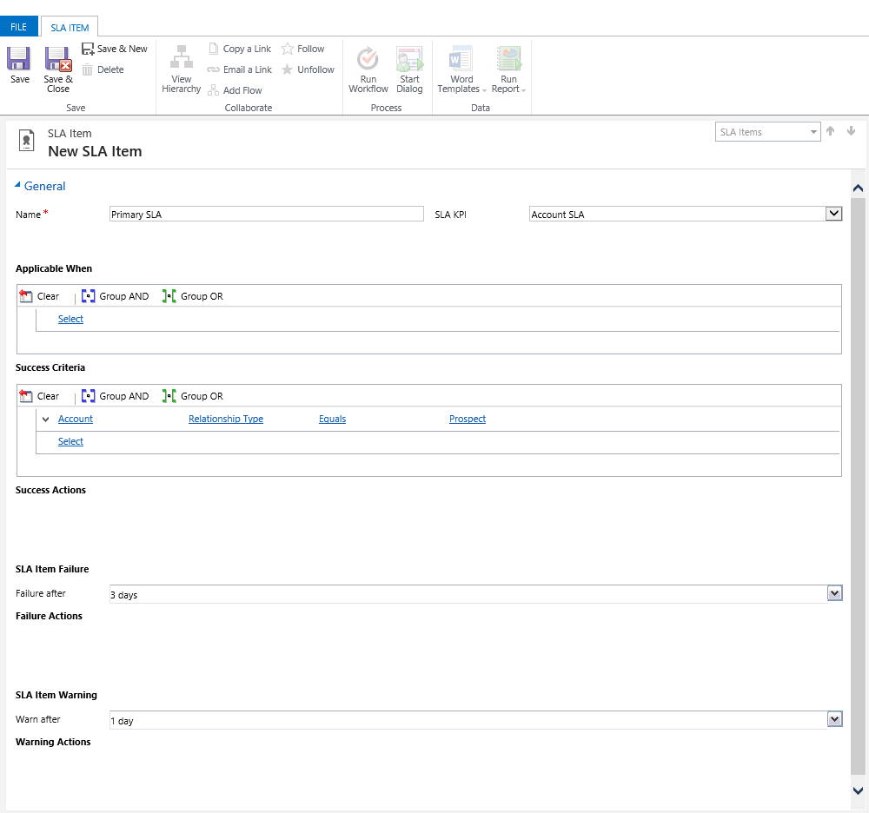
Create an SLA Item

Slide 24
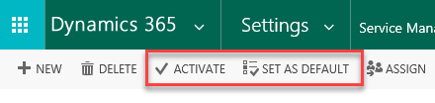
Final Steps
Activate the SLA
Set as Default

Slide 25
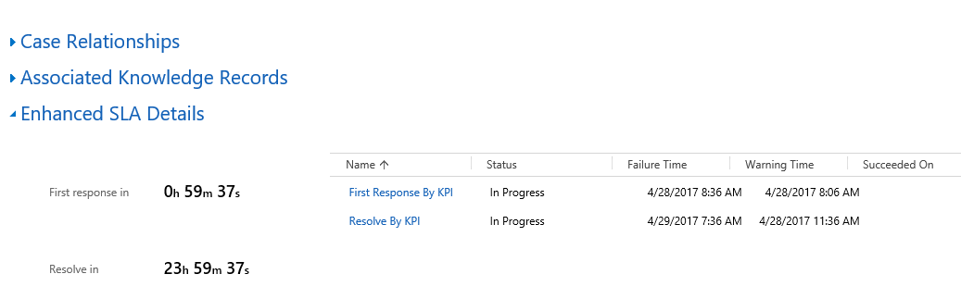
SLA in Action (Case)

Slide 26
Entitlements

Slide 27
Entitlements
Similar to Contracts in previous versions of Dynamics CRM
Like Processes, Entitlements must be activated before use
Entitlements are defined at the record level
A default entitlement can be used to automatically assign an Entitlement when a new case is created

Slide 28
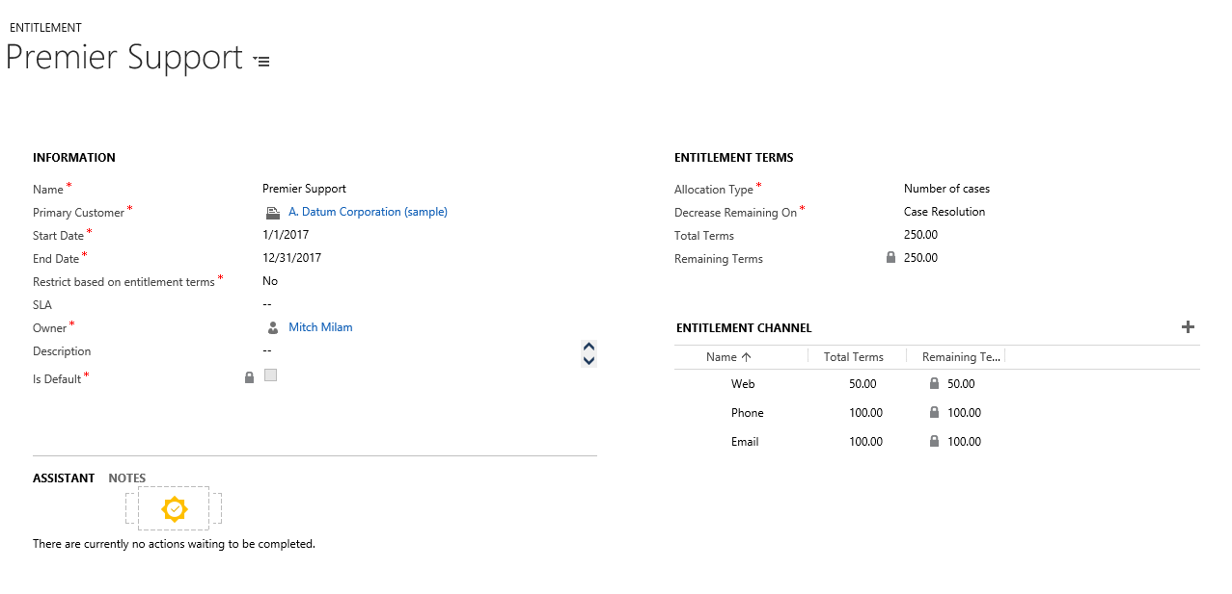
Create an Entitlement

Slide 29
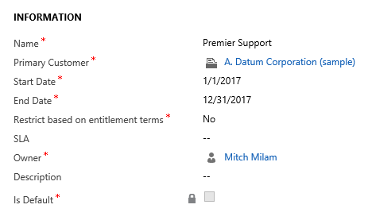
Entitlement Information
Primary Customer
Customer the Entitlement is tied to
Start Date and End Date
Duration of the Entitlement
SLA
Is the Entitlement tied to an SLA?
Is Default
Is this the default Entitlement for this record?
Restrict based on entitlement terms
Prevents a new case from being created if the Entitlement is term is over or exhausted

Slide 30
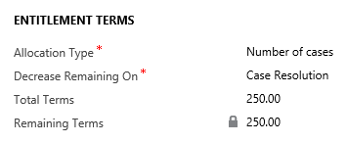
Entitlement Terms
Allocation Type
Number of Cases
Number of hours
Decrease Remaining On
Case Creation
Case Resolution
Total Terms
How many do we start with?
Remaining Terms
How many do we currently have?

Slide 31
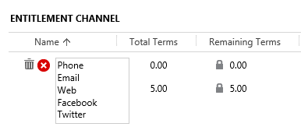
Entitlement Channels
*Channels are found in the Case Origin global option set

Slide 32
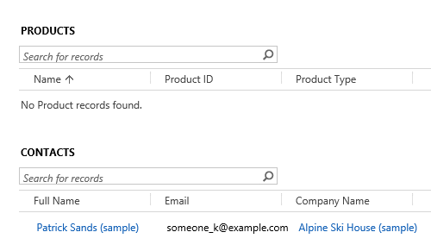
Restricting Entitlements

Slide 33
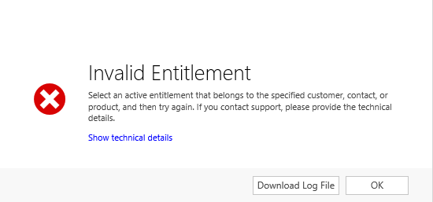
Restricting Entitlements

Slide 34
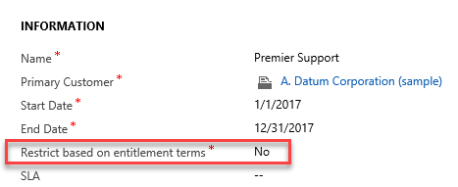
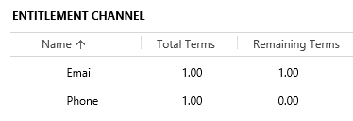
Restricting Entitlements

Slide 35
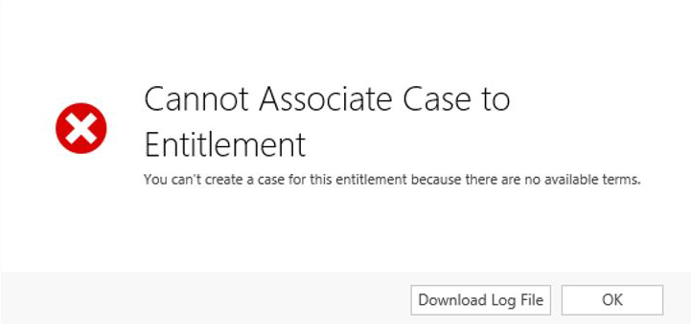
Restricting Entitlements

Slide 36
Questions?

Slide 37
Thank You

